Slide 1
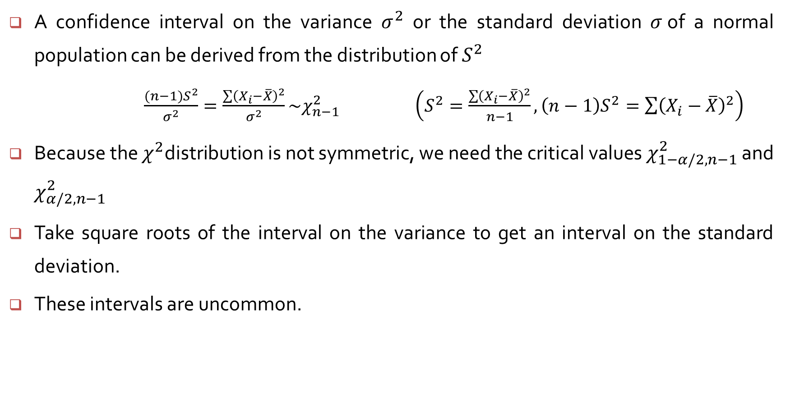
Confidence intervals for Variance
A confidence interval on the variance $σ^{2}$ or the standard deviation $σ$of a normal population can be derived from the distribution of $S^{2}$
$\frac{(n−1)S^{2}}{σ^{2}}=\frac{\sum{{\left(X_{i}−\overline{X}\right)}^{2}}}{σ^{2}}\sim χ_{n−1}^{2}$ $\left(S^{2}=\frac{\sum{{\left(X_{i}−\overline{X}\right)}^{2}}}{n−1},\left(n−1\right)S^{2}=\sum{{\left(X_{i}−\overline{X}\right)}^{2}}\right)$
Because the $χ^{2}$distribution is not symmetric, we need the critical values $χ_{1−α/2,n−1}^{2}$ and $χ_{α/2,n−1}^{2}$
Take square roots of the interval on the variance to get an interval on the standard deviation.
These intervals are uncommon.

Slide 2
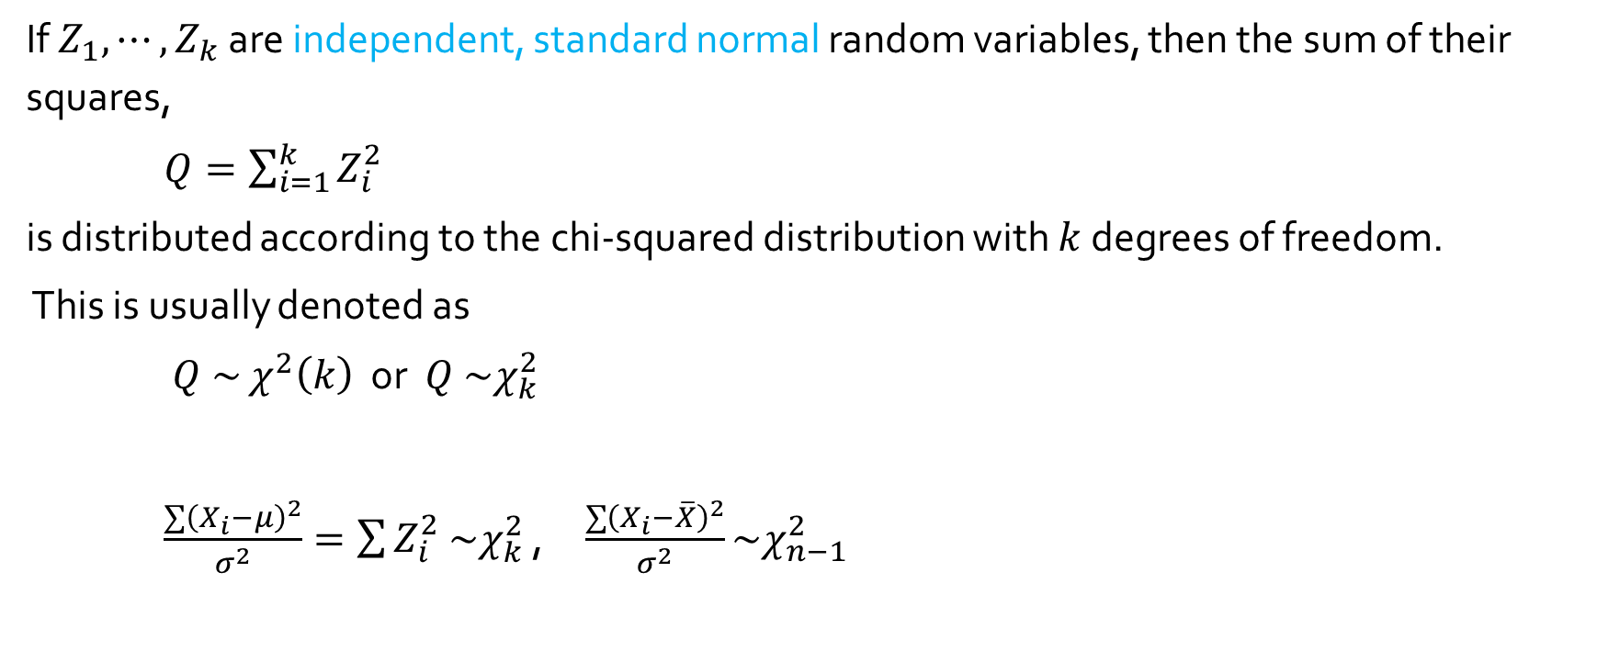
If $Z_{1}, ⋯,Z_{k}$ are independent, standard normal random variables, then the sum of their squares,
$Q=\sum_{i=1}^{k}{Z_{i}^{2}}$
is distributed according to the chi-squared distribution with $k$ degrees of freedom.
This is usually denoted as
$Q \sim$ $χ^{2}\left(k\right)$ or $Q \sim χ_{k}^{2}$
$\frac{\sum{{\left(X_{i}−μ\right)}^{2}}}{σ^{2}}=\sum{Z_{i}^{2}}$ $\sim χ_{k}^{2}$ , $\frac{\sum{{\left(X_{i}−\overline{X}\right)}^{2}}}{σ^{2}}\sim χ_{n−1}^{2}$

Slide 3
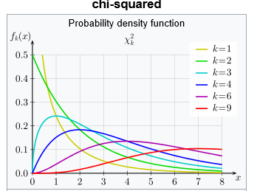

Gamma distribution
f$\left(x;α, β\right)=\left\{\begin{matrix}\frac{1}{β^{α}Γ\left(α\right)}x^{α−1}e^{−x/β} & x≥0 \\ 0 & otherwise\end{matrix}\right.$
Chi-squared distribution :
$shape parameter : α=\frac{k}{2}$
scale parameter :$β=2$
f$\left(x;α, β\right)=\left\{\begin{matrix}\frac{1}{2^{k/2}Γ\left(k/2\right)}x^{k/2−1}e^{−x/2} & x≥0 \\ 0 & otherwise\end{matrix}\right.$

Slide 4

Confidence intervals of $σ^{2}$
From the theorem,
$P\left(χ_{1−α/2,n−1}^{2}≤\frac{(n−1)S^{2}}{σ^{2}}≤χ_{α/2,n−1}^{2}\right)=1−α$
We get the inequalities
$\frac{(n−1)S^{2}}{χ_{α/2,n−1}^{2}}≤σ^{2}≤$ $\frac{(n−1)S^{2}}{χ_{1−\frac{α}{2},n−1}^{2}}$
A 100($1−α$)% confidence interval for the variance $σ^{2}$ of a normal population is
$\left(\frac{(n−1)S^{2}}{χ_{α/2,n−1}^{2}}, \frac{(n−1)S^{2}}{χ_{1−\frac{α}{2},n−1}^{2}}\right)$

Slide 5
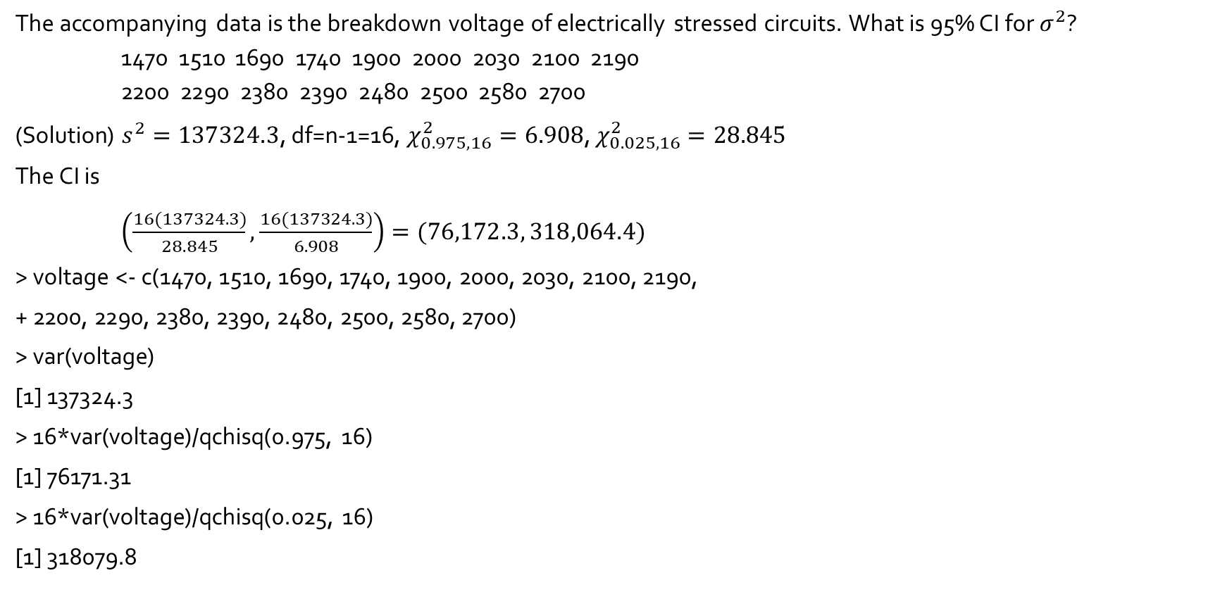
Example 7.15
The accompanying data is the breakdown voltage of electrically stressed circuits. What is 95% CI for $σ^{2}$? 1470 1510 1690 1740 1900 2000 2030 2100 2190 2200 2290 2380 2390 2480 2500 2580 2700
(Solution) $s^{2}=137324.3$, df=n-1=16, $χ_{0.975,16}^{2}=6.908$, $χ_{0.025,16}^{2}=28.845$
The CI is
$\left(\frac{16(137324.3)}{28.845},\frac{16(137324.3)}{6.908}\right)=(76,172.3, 318,064.4)$
> voltage <- c(1470, 1510, 1690, 1740, 1900, 2000, 2030, 2100, 2190,
+ 2200, 2290, 2380, 2390, 2480, 2500, 2580, 2700)
> var(voltage)
[1] 137324.3
> 16*var(voltage)/qchisq(0.975, 16)
[1] 76171.31
> 16*var(voltage)/qchisq(0.025, 16)
[1] 318079.8

